Slide 1

PROJECT REVIEW

Slide 2
Movie Recommendation System with Collaborative Filtering using KNN
Presented By
SANTHOSH KUMAR KARAMTHOT (197R1A0520)
RUCHITHA KEERTHI (207R5A0505)
NEELIMA KURUMULA (207R5A0502)
Under the Guidance of
Dr.Punyaban Patel
(Professor)

Slide 3
ABSTRACT:
Recommender systems are efficient tools for filtering online information, which is widespread owing to the changing habits of computer users, personalization trends, and emerging access to the internet. Even though the recent recommender systems are eminent in giving precise recommendations, they suffer from various limitations and challenges like scalability, cold-start etc. Due to the existence of various techniques, the selection of techniques becomes a complex work while building application-focused recommender systems. In addition, each technique comes with its own set of features, advantages and disadvantages which raises even more questions, which should be addressed.
In the spread of information, how to quickly find one’s favorite movie in a large number of movies become a very important issue. Personalized recommendation system can play an important role especially when the user has no clear target movie. we design and implement a movie recommendation system prototype combined with the actual needs of movie recommendation through researching of KNN algorithm and collaborative filtering algorithm. Finally, the test results showed that the system has a good recommendation effect.

Slide 4
EXISTING SYSTEM:
Recommender systems are software applications that suggest or recommend items or products to users. These systems use users' preferences or interests and an appropriate algorithm in finding the relevant or desired items or products. Recommender systems deal with information overload problems by filtering items that potentially may match the users' preferences or interests. These systems aid users to efficiently overcome the problem by filtering irrelevant information when users search for desired information.

Slide 5
DISADVANTAGES:
Content Based:
· Content based Recommendation result is intuitive and easy to interpret;
· No need for user’s access history data;
· No new item problem and no sparsity problem;
· Supported by the mature technology of classification learning.
Collaborative filtering:
· Poor scalability;
· New user and new item problem;
· The recommendation quality limited by the history data set.

Slide 6
PROPOSED SYSTEM:
· To find out the related content of the user in a given set of collection and to his interest feed.
· Providing the accurate and most confined results by using the distance between two vectors model.
· By providing accurate results by the usage of movies datasets by IMDB in the existing project work.
· Classifying the users interest movies and recommend them to their searches fast by
help libraries and software as pip, panda etc.

Slide 7
ADVANTAGES:
Content Based:
· Recommendation result is intuitive and easy to interpret;
· No need for user’s access history data;
· No new item problem and no sparsity problem;
· Supported by the mature technology of classification learning.
Collaborative filtering:
· No need for professional knowledge;
· Performance improving as the increasing of the user number;
· Easy to find user’s new interesting point;
· Complex unstructured item can be processed.
Eg. Music, Video, etc.

Slide 8

HARDWARE REQUIREMENTS:
A PC with Windows/Linux OS
Processor with 1.7-2.4gHz speed
Minimum of 8GB RAM
2GB Graphic card

Slide 9
SOFTWARE REQUIREMENTS:
Text Editor (VS-code)
Google Colab Editor
Python libraries

Slide 10
Novelty of Project:
In this Project we are using Collaborative Filtering and KNN algorithm. By using this Methods there is an increasing realization in Recommender System. And giving the accurate result.

Slide 11
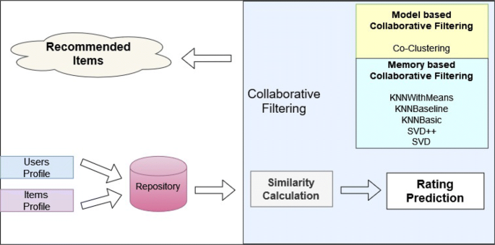
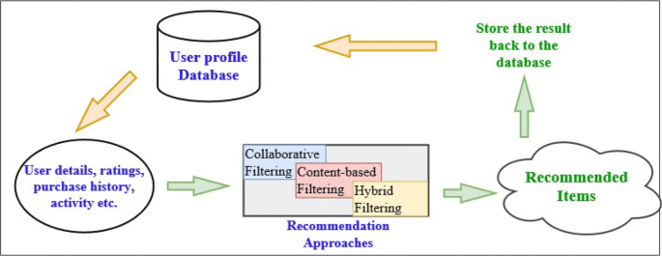
Architecture:

Slide 12
Module:
There are three module in our projects:
Input Module
Processing Module
Output Module

Slide 13
Module:
Recommended movie output
KNN Algorithm
Similar Movies
Recommended
Libraries
Pre processing of data
Processing Module
Input from users

Slide 14
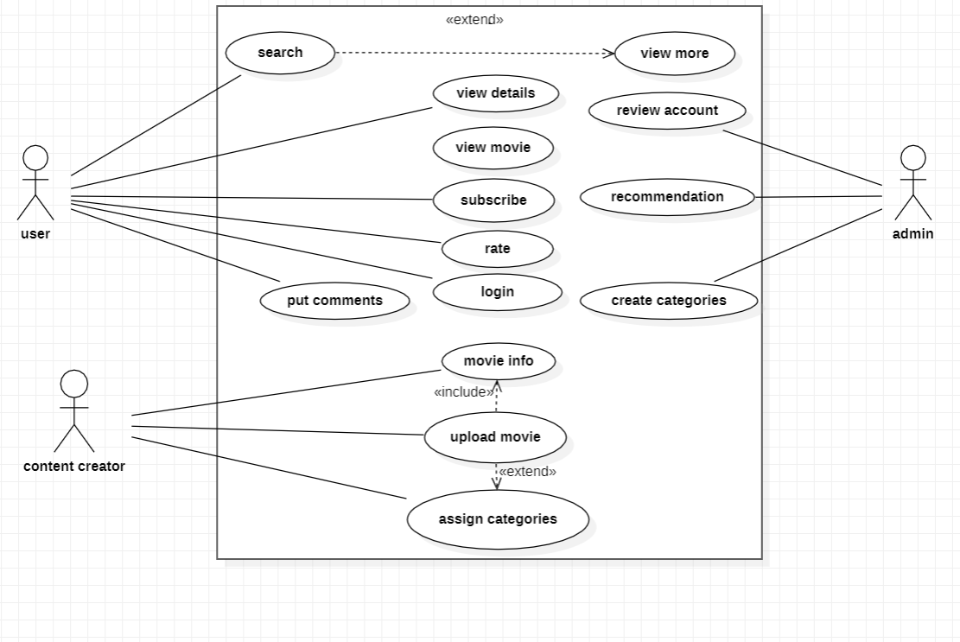
Use Case Diagram:

Slide 15
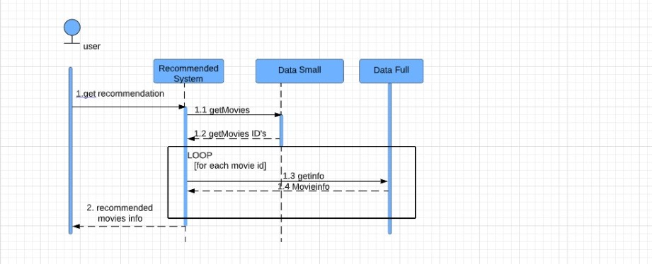
Sequence Diagram:

Slide 16
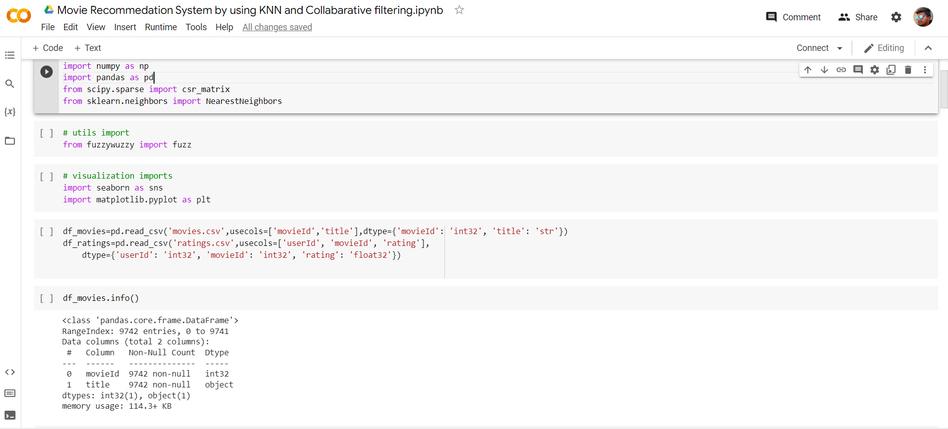
Sample Code:

Slide 17
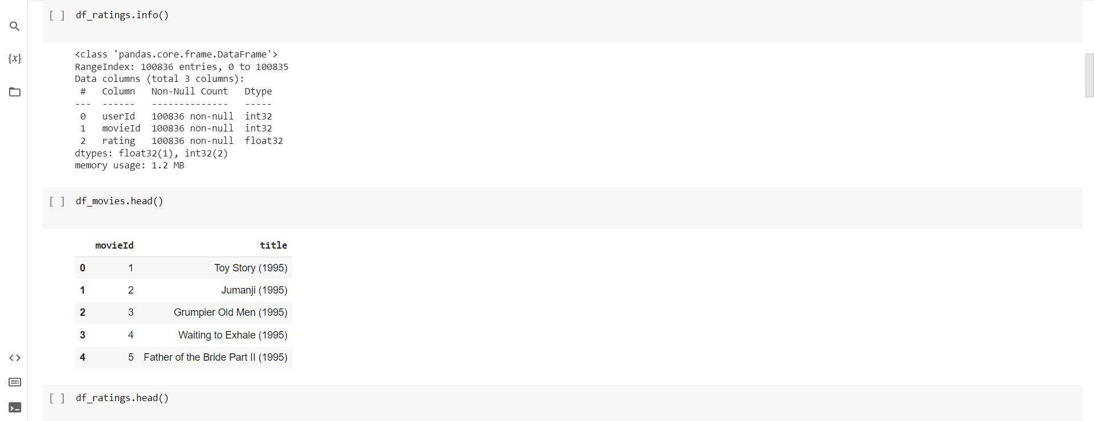
…

Slide 18
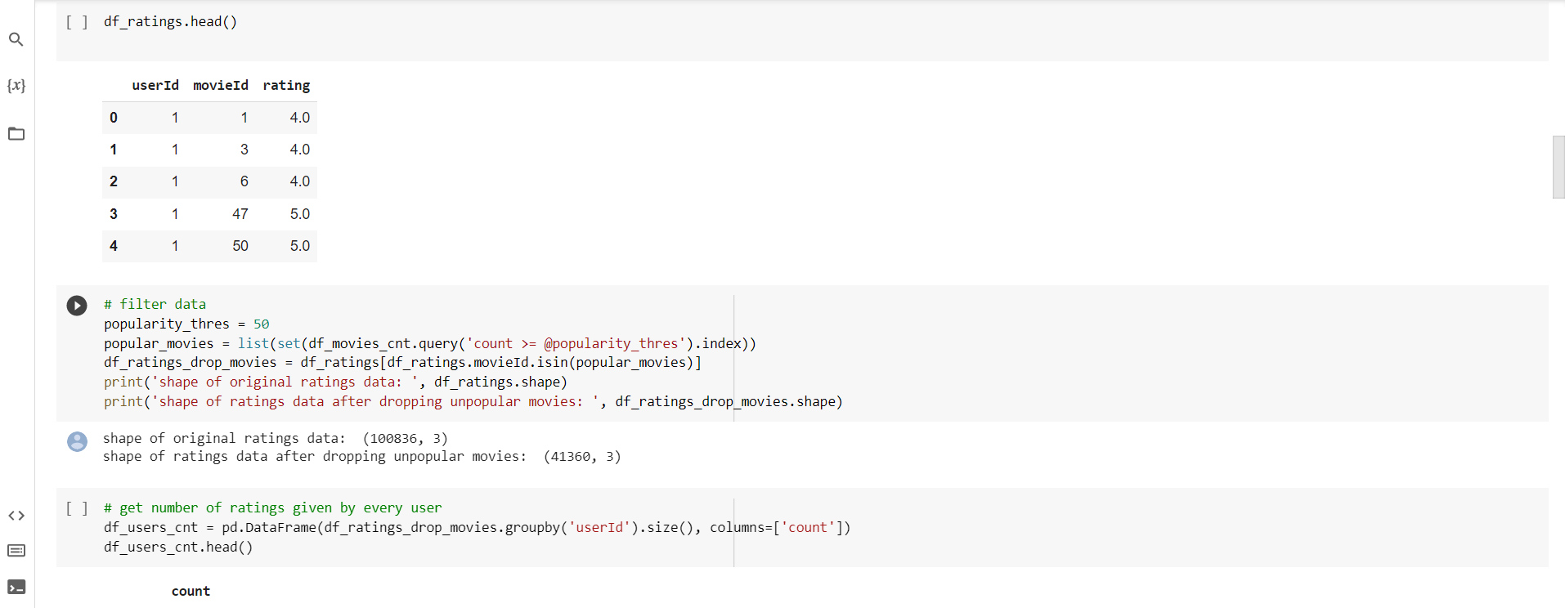
…

Slide 19
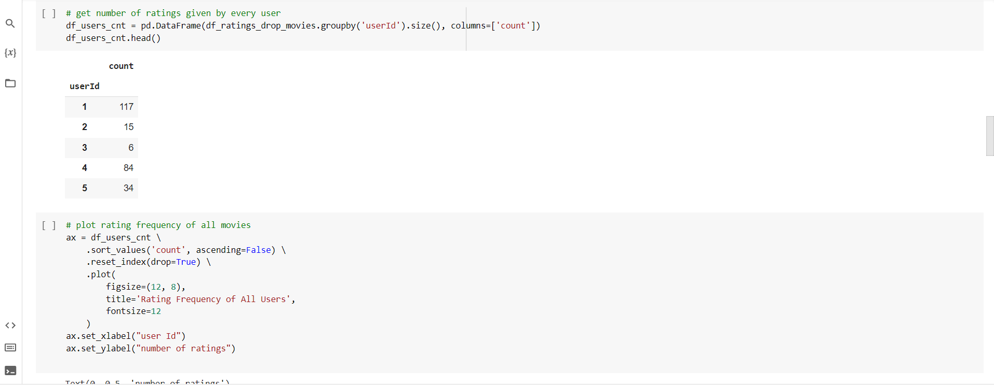
…

Slide 20
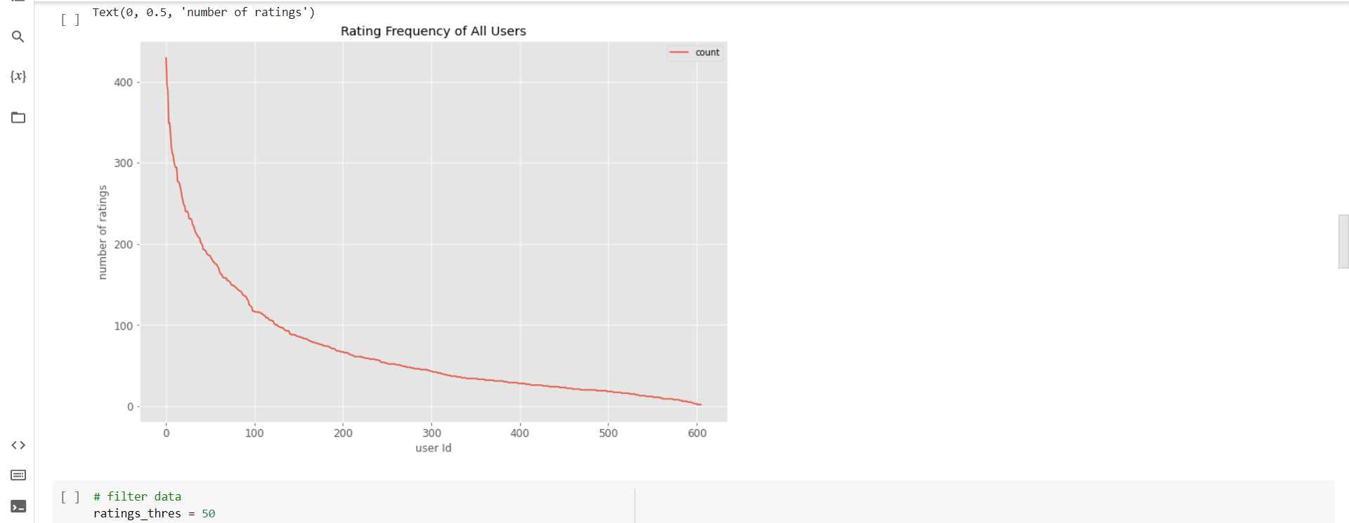
…

Slide 21
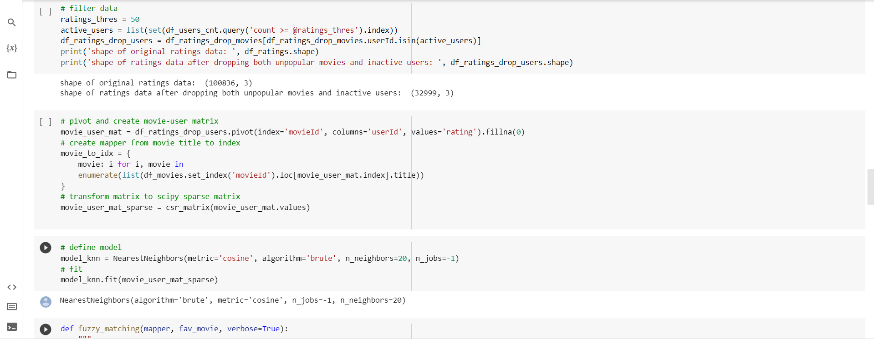
…

Slide 22
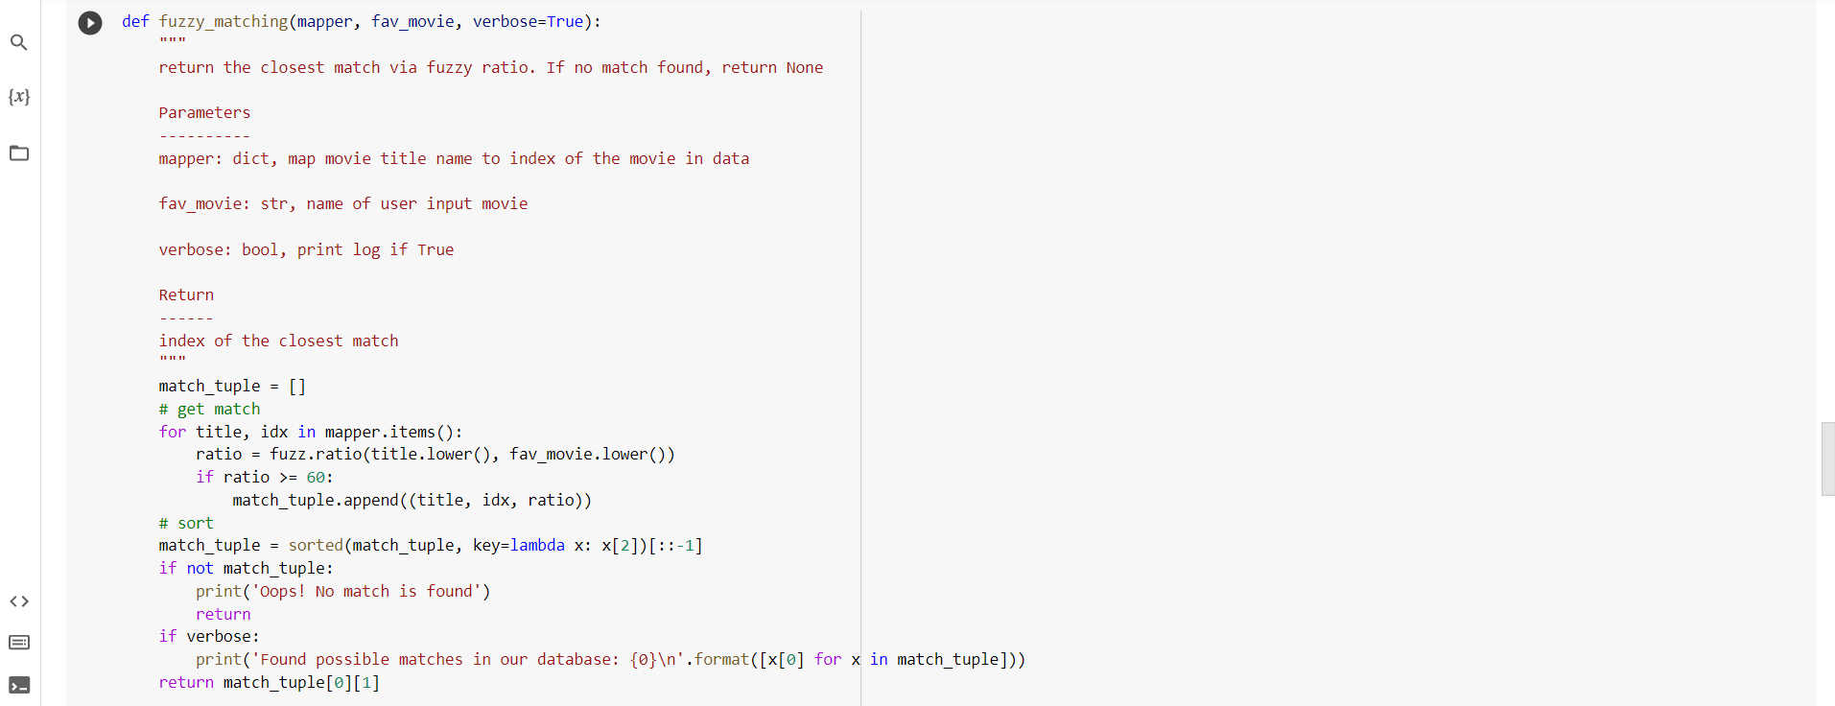
…

Slide 23
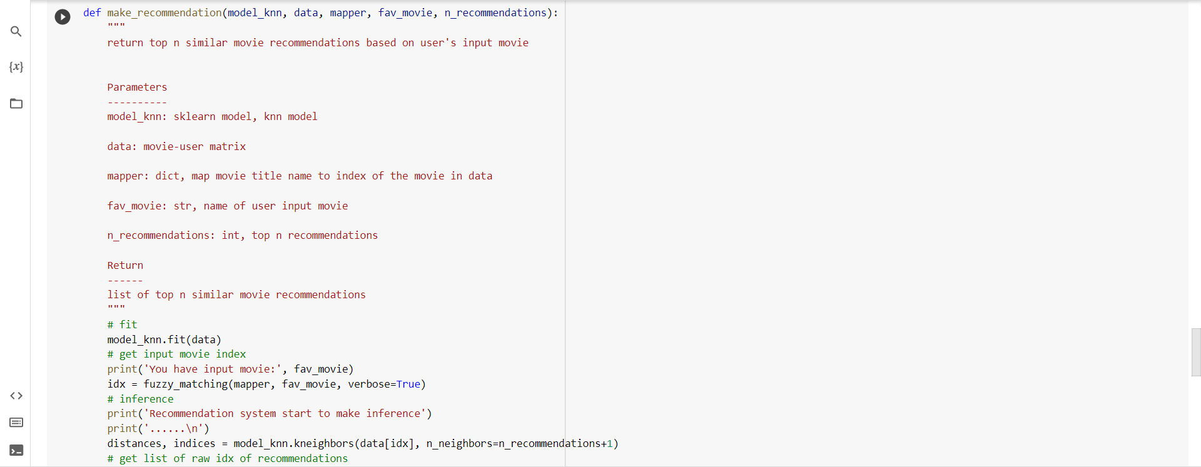
…

Slide 24
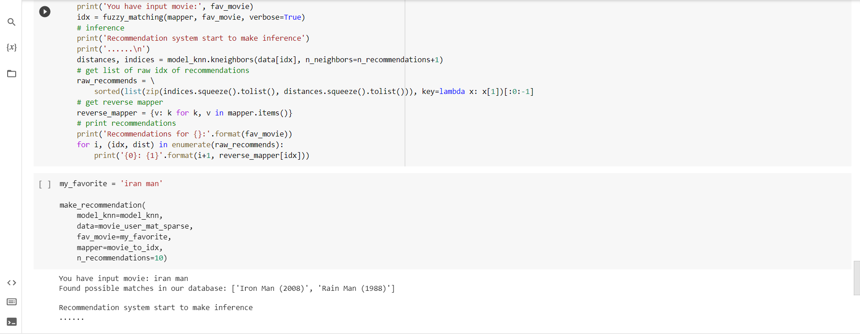
...

Slide 25
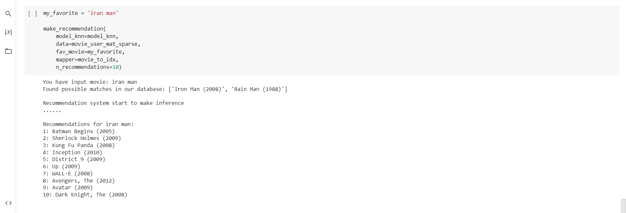
Result Screenshot:

Slide 26
CONCLUSION:
Under the condition of massive information, the requirements of movie recommendation system from film amateur are increasing. This article designs and implements a complete movie recommendation system prototype based on the KNN algorithm, collaborative filtering algorithm and recommendation system technology. We give a detailed design and development process, and test the stability and high efficiency of experiment system through professional test. This project has reference significance for the development of personalized recommendation technology.

Slide 27
Future Enhancement:
Recommender systems can be a very powerful tool in a company’s arsenal, and future developments are going to increase business value even further. Some of the applications include being able to anticipate seasonal purchases based on recommendations, determine important purchases, and give better recommendations to customers which can increase retention and brand loyalty.
Most businesses will have some use for recommender systems, and I encourage everyone to learn more about this fascinating area.

Slide 28
References:
1.C. S. M. Wu, D. Garg and U. Bhandary, "Movie Recommendation System Using Collaborative Filtering", 2018 IEEE 9th International Conference on Software Engineering and Service Science (ICSESS), pp. 11-15, Nov. 2018.
2. W. Liang, G. Lu, X. Ji, J. Li and D. Yuan, "Difference factor’ KNN collaborative filtering recommendation algorithm", International Conference on Advanced Data Mining and Applications, pp. 175-184, 2014, December.

Slide 29
Github Link:
https://github.com/197R1A0520/Movie-Recommadation-System

Slide 30

THANK YOU

